Slide 1
AGILE AND ITS SIGNIFICANCE
UNIT - II

Slide 2
OVER VIEW
Basic ideas and principles of agile methods.
Classification of methods.
Agile hype?
Specific agile methods, including Scrum and XP.

Slide 3
AGILE DEVELOPMENT
Agile development methods apply time boxed iterative and evolutionary development, adaptive planning, promote evolutionary delivery, and include other values and practices that encourage agility—rapid and flexible response to change

Slide 4
It is not possible to exactly define agile methods, as specific practices vary
However, short time boxed iterations with adaptive, evolutionary refinement of plans and goals is a basic practice various methods share

Slide 5
Agile methods promote practices and principles that reflect an agile responsiveness of simplicity,
Lightness
communication
self-directed teams
programming over documenting, and more

Slide 6
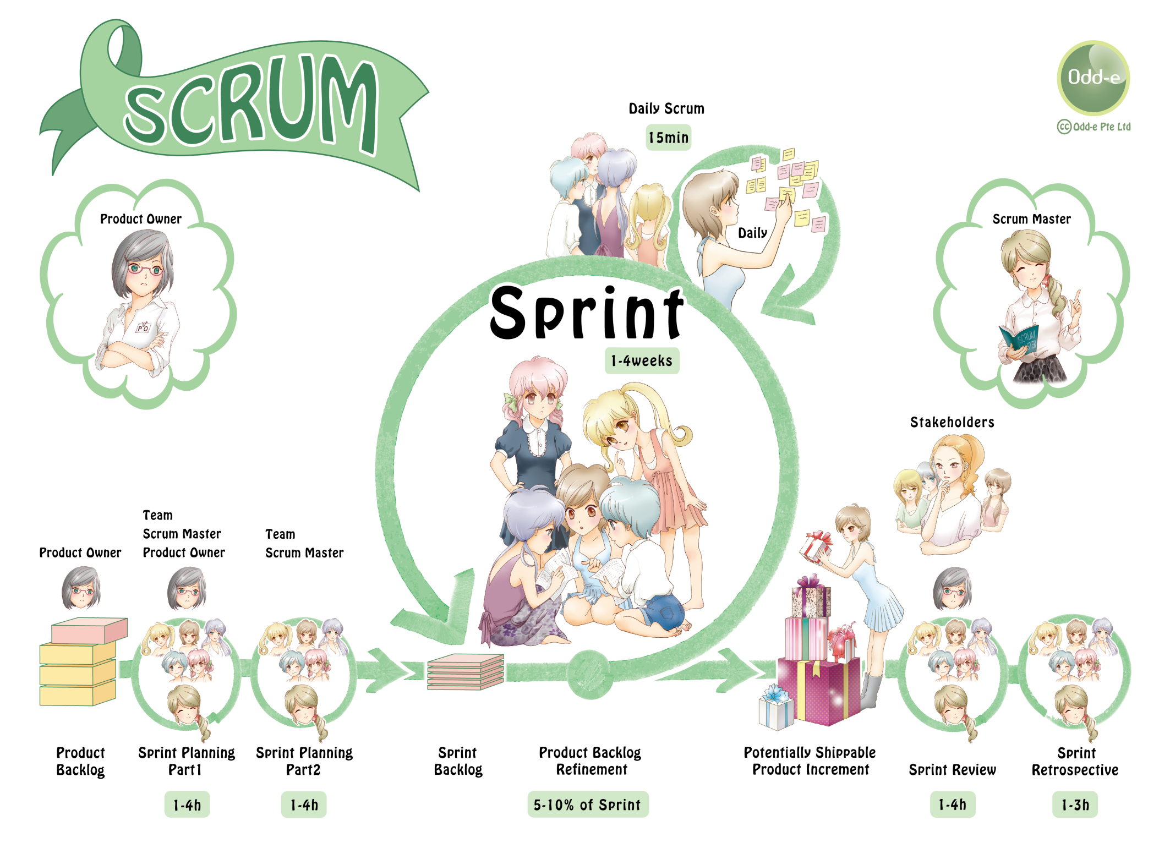

Slide 7
Example practices
SCRUM
Scrum include working in a common project room and self-directed teams that coordinate through a daily stand-up meeting with special questions each member answers

Slide 8
XP
XP include using terse(short) notes on paper story cards to summarize requirements
programming in pairs

Slide 9
working in a common project room with full-time participation by requirement donors so that detailed written requirements can be replaced with ongoing verbal explanations

Slide 10
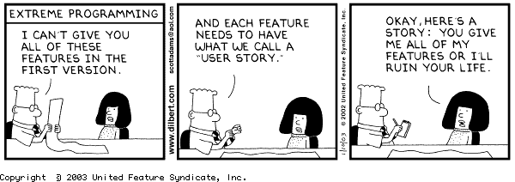

Slide 11
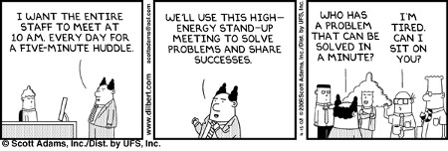

Slide 12
Classification of Methods
Cycles of ceremony
degree of ceremony—the amount of method weight in terms of documentation, formal steps, review, and so forth

Slide 13
Cycles
The number and length of iterations
For example, single-pass waterfall has no iterations; at the other end, an Evo project could have very many —one iteration per week.

Slide 14
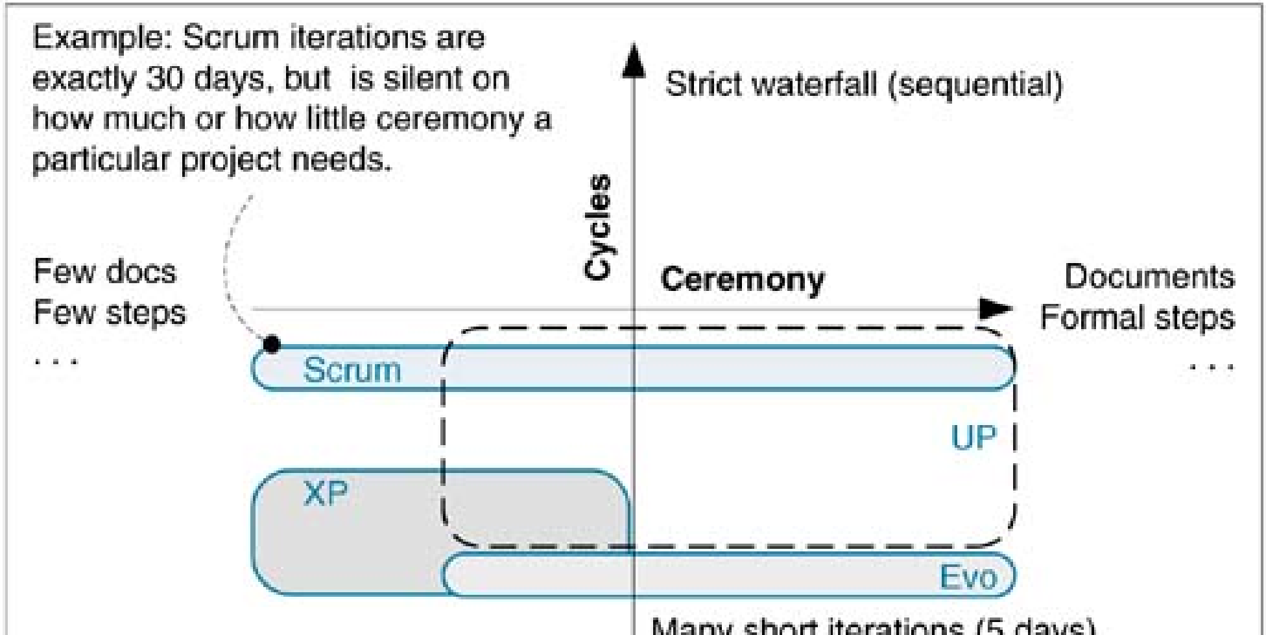

Slide 15
The Agile Manifesto and Principles
In 2001 a group interested in iterative and agile methods met to find common ground.
Out of this came the Agile Alliance (www.agilealliance.com) with a manifesto and statement of principles

Slide 16
Individuals and interactions over processes and tools
Working software over complete documentation
Customer collaboration over contract negotiation
Responding to change over following a plan

Slide 17
The Agile Principles
1. Our highest priority is to satisfy the customer through early and continuous delivery of valuable software.
2. Welcome changing requirements, even late in development. Agile processes harness change for the customer's competitive advantage.

Slide 18
3. Deliver working software frequently, from a couple of weeks to a couple of months, with a preference to the shorter time scale
4. Business people and developers must work together daily throughout the project

Slide 19
5. Build projects around motivated individuals. Give them the environment and support they need, and trust them to get the job done
6. The most efficient and effective method of conveying information to and within a development team is face-to-face conversation

Slide 20
7. Working software is the primary measure of progress
8. Agile processes promote sustainable development
9. The sponsors, developers, and users should be able to maintain a constant pace indefinitely
10. Continuous attention to technical excellence and good design enhances agility.

Slide 21
11. Simplicity—the art of maximizing the amount of work not done—is essential
12. The best architectures, requirements, and designs emerge from self-organizing teams.
13. At regular intervals, the team reflects on how to become more effective, then tunes and adjusts its behavior accordingly

Slide 22
Agile Project Management
Jim High smith, an Agile Alliance founder and creator of the Adaptive Software Development
summarizes nine principles for the agile project manager

Slide 23
Deliver something useful to the client; check what they value
Support committed stakeholders
Employ a leadership-collaboration style
Build competent, collaborative teams.
Enable team decision making.

Slide 24
Use short time boxed iterations to quickly deliver features.
Encourage adaptability.
Champion technical excellence.
9. Focus on delivery activities, not process-compliance activities.

Slide 25
Augustine and Woodcock, two managers with experience in XP-oriented projects, recommend six practices
1. Guiding Vision – Establish a guiding vision for the project and continuously strengthen it through words and actions.

Slide 26
Teamwork & Collaboration – Facilitate collaboration and teamwork through relationships and community
3. Simple Rules – Establish and support the team's set of guiding practices, such as Scrum or XP.

Slide 27
4. Open Information – Provide visible and open access to project management and other information
5. Light Touch – Apply just enough control to foster developing behavior in a self-directed team

Slide 28
6. Agile Vigilance – Strengthen the vision, follow or adapt the rules, listen to the people.

Slide 29
A theme of agile project management in Scrum and XP is the devolution of both control and planning to the entire team, not the manager
The manager does not create a work breakdown structure, schedule, or estimates; this is done as a team

Slide 30
The manager does not (usually) tell people what to do.
The manager does not define and assign many detailed team roles and responsibilities.

Slide 31
The project manager role emphasizes coaching, providing resources, maintaining the vision, removing obstacles, promoting agile principles, etc.

Slide 32
Embrace Communication and Feedback
The manifesto and principles, and agile methods have a theme of working to increase communication, especially face-to-face conversation
This is illustrated in practices such as the daily Scrum meeting and XP's requirement to have onsite customers sitting full-time in the common project room

Slide 33
Simple Practices and Project Tools
Most agile methods embrace do the simplest thing that could possibly work
This applies not only to software design, but to all project practices.
Most agile methods promote a "low-tech, high-touch" approach to project and management tools.

Slide 34
Empirical vs. Defined & Prescriptive Process
agile methods promote empirical rather than defined processes
defined process (also known as a prescriptive process) has many predefined and ordered activities to be followed during development

Slide 35
Defined processes are suitable for predictable manufacturing domains.

Slide 36
Empirical processes are used for high-change and unstable domains; rather than many sequenced activities
They are based on frequent measurement and dynamic response to variable events
(Eg. For example, Scrum is silent on the activities of an iteration, other than the daily Scrum meeting as the measurement and response mechanism)

Slide 37
Principle-Based versus Rule-Based
agile methods is as more principle-based than rule-based.
Rather than a predefined set of rules regarding the many roles, team organization, responsibilities, relationships, and activities, the team and manager are primarily guided by the principles embodied in the Agile Manifesto and Principles

Slide 38
Sustainable Discipline: The Human Touch
The creators of a few agile methods (e.g., XP and Crystal) recognized that human factors such as enjoyment, simplicity, short-term reward, peer pressure, and lots of gain for the pain are important ingredients to create fertile soil for sustainable self-discipline with practices

Slide 39
Team as a Complex Adaptive System
Some agile methods (including Scrum and Adaptive Software Development) speak of a healthy development team as a complex adaptive system (CAS).
The agile methods promote the value that, for creative inventive projects

Slide 40
A CAS-inspired culture of self-organizing teams is more valuable than control or planning by managers.
This is reflected in Agile Principle
(For example, Scrum teams are self-organizing (no management assignment of roles or tasks); team-level organization and adaptation is enabled by the daily Scrum meeting with its special questions that provide each member with the information to make collective decisions)

Slide 41
Agile Hype?
Be adaptable, collaborative, delivery driven, people oriented, customer focused, guided by a vision
develop in short iterations; manager is coach" and most other "agile" messages are hardly new.

Slide 42
Iterative development had replaced the waterfall on major projects by the 1970s
Many so-called agile messages are repetition from trends of prior decades.
But, viewing as a whole all the principles and practices of Scrum or XP (for example), these methods have a fresh flavor

Slide 43
They push the envelope of embracing changing requirements, communication, self-organizing teams, adaptive planning, and so forth.
Some practices—such as test-driven development and continuous integration—are relatively new.

Slide 44
Specific Agile Methods
Scrum and XP are widely applied agile methods—the two most common, according to at least one survey
Some "XP" adoption is misunderstood as simply "not the waterfall" and the teams are merely practicing iterative and evolutionary development or Programming without documentation" and calling this XP.

Slide 45
Scrum
Scrum's distinctive emphasis among the methods is its
strong promotion of self-organizing teams
daily team measurement
avoidance of following predefined steps

Slide 46
Some key practices include a
daily stand-up meeting (the Scrum meeting) with special questions
30-calendar-day iterations
A demo to external stakeholders at the end of each iteration.

Slide 47
XP
XP is probably the most well known agile method
It emphasizes collaboration
Quick and early software creation
skillful development practices.

Slide 48
It is founded on four values:
Communication,
Simplicity
Feedback
Courage.

Slide 49
It includes 12 core practices, including the whole team working together in a common room
pair programming
Constant refactoring and
test-driven development

Slide 50
Crystal Methods
The Crystal family of agile methods were developed by Alistair Cockburn
While acknowledging the necessity of an iterative lifecycle, in this group of methods Cockburn stresses the primacy of "people ware" issues over process (communication, education, and so on.)

Slide 51
His definition of software development shows this emphasis: "a cooperative game of invention and communication.“
Different versions of Crystal (Clear, Yellow, …) contain increasing method weight (or process ceremony in terms of defined and ordered steps, documents, reviews, etc.) as a function of staff size, criticality, and project priority

Slide 52
(i.e)choose size and criticality, and this maps to a particular version of Crystal with a recommended method weight
Cockburn has created a scale to illustrate matching method configurations to these factors

Slide 53
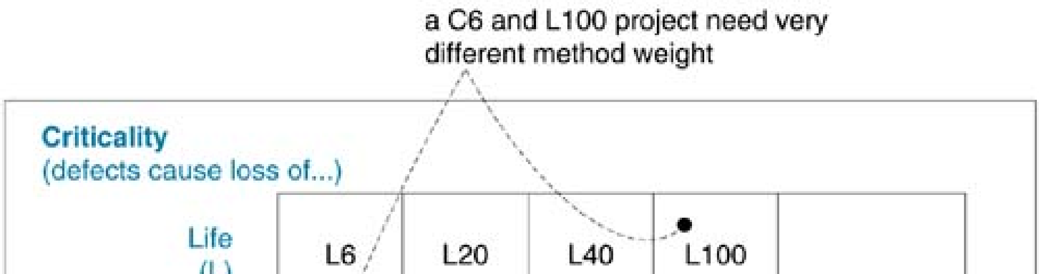
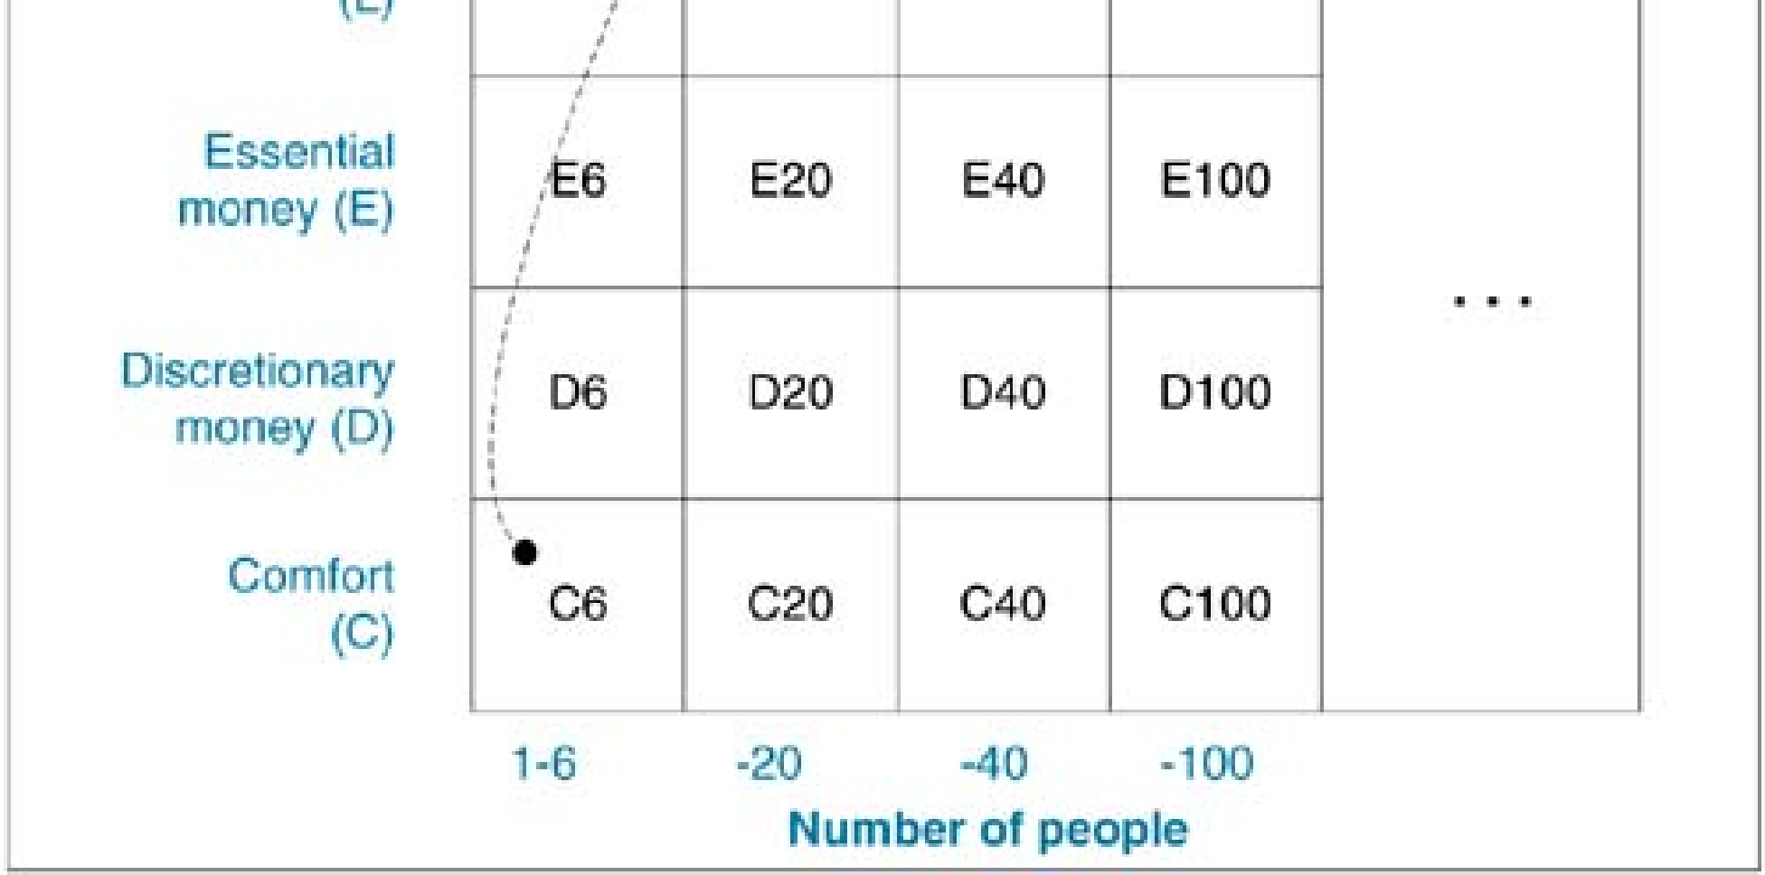

Slide 54
For example, E6 means a project of 1–6 people, where the worst that can happen from a system failure is loss of essential money

Slide 55
Agile Modeling
Scott Ambler summarizes best practices that skilled iterative modelers apply
Agile Modeling promotes the collaborative "low-tech, high-touch" creation of barely good enough, disposable models to aid understanding and communication.
Practices encourage speed, simplicity, and creative flow.

Slide 56
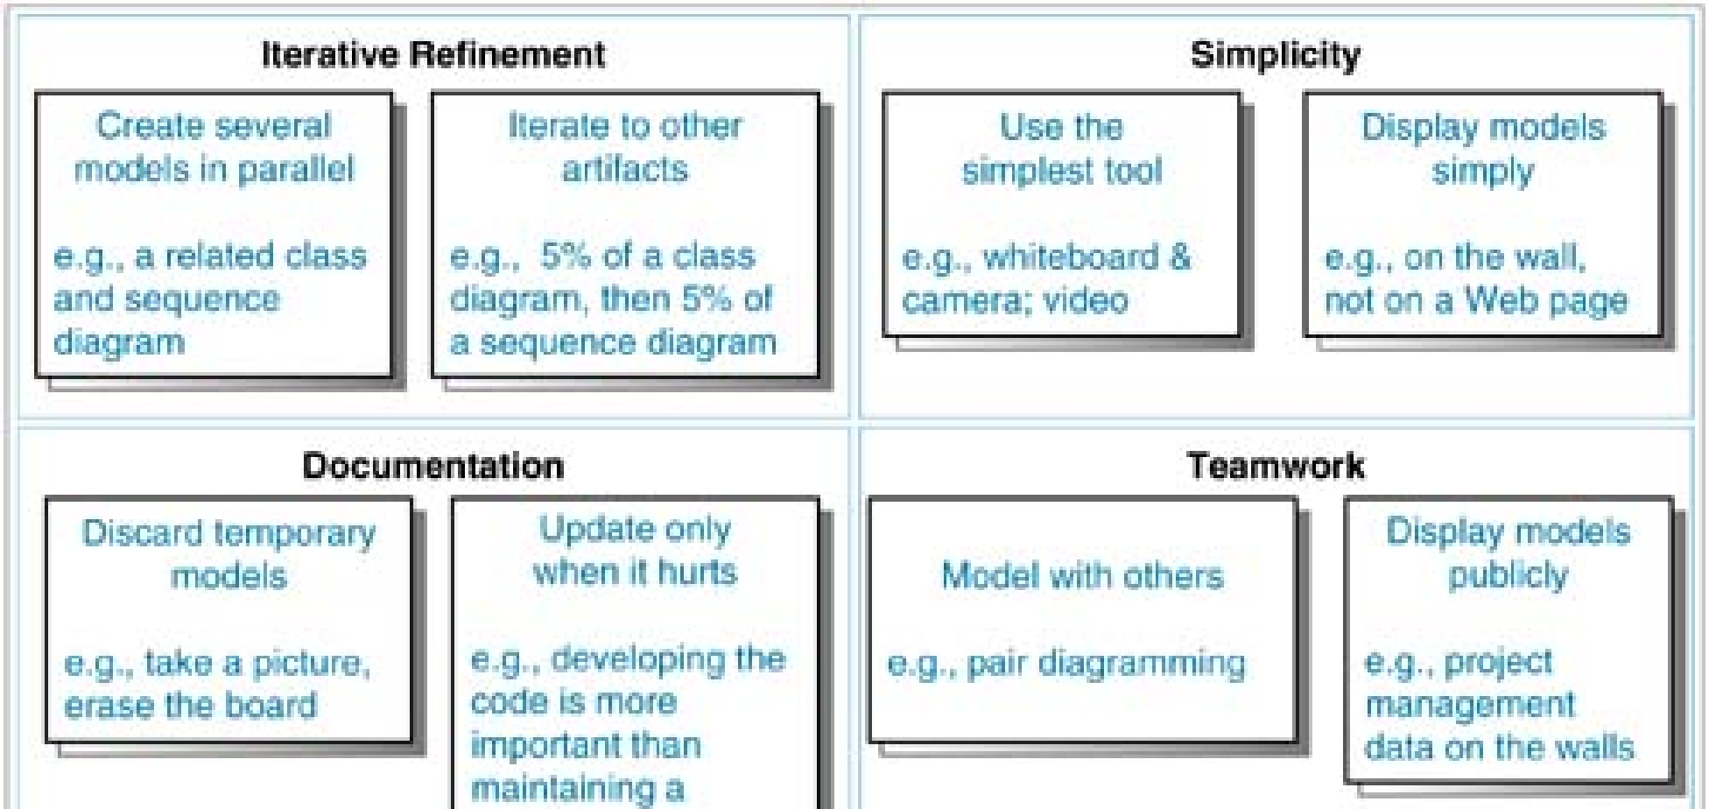

Slide 57
In addition to Scrum, XP, and the Crystal methods, there are now a host of other agile-oriented practices or methods in use or publication
Adaptive Software Development (ASD) from Jim Highsmith [Highsmith00]; inspired by the complex adaptive systems viewpoint, Rapid Application Development methods, and more.

Slide 58
Dynamic Solutions Delivery Model (DSDM)
From a group of 16 Rapid Application Development (RAD) experts Stapleton97] (originally called Dynamic Systems Development Method).
It continues to be refined by a member consortium.

Slide 59
Feature-Driven Development (FDD) primarily from Jeff De Luca, with contributions by Peter Coad
Lean Development from Mary and Tom Poppen dieck
Pragmatic Programming from Andy Hunt and Dave Thomas is not a complete method, but contains development practices sympathetic to an agile development approach.

Slide 60
Story :
Case study

Slide 61
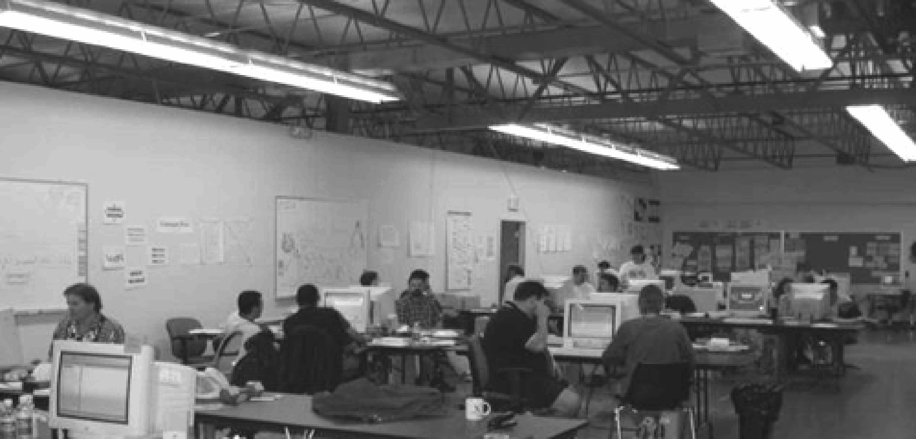
Story :
Common project room

Slide 62

Scrum:

Slide 63
The Facts of Change on Software Projects
The Uncertainty Principle in software : Uncertainty is inherent and inevitable in software projects and processes
The data summarized in Figure 5.1, based on a large study of software projects [Jones97], illustrates that software development is a domain of inventive high-change projects.

Slide 64
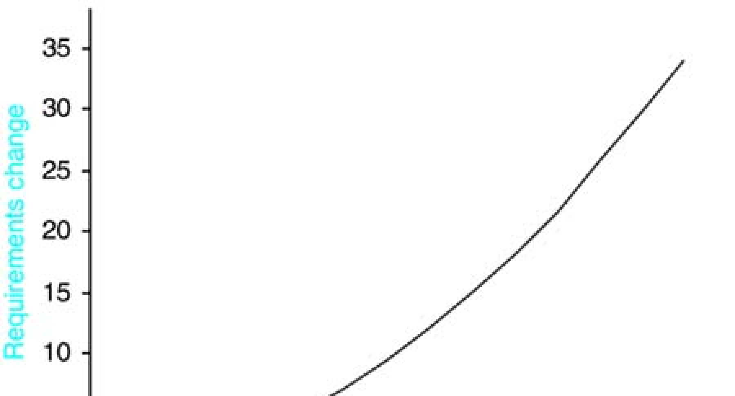
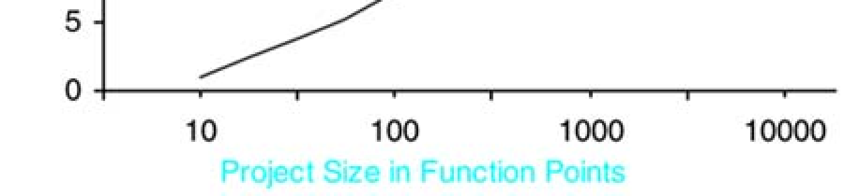

Slide 65
The X axis plots project size in function points, a language-independent measure of system complexity.
The Y axis plots the estimate of overall change or creep in requirements

Slide 66
Key Motivations for Iterative Development
Iterative development is lower risk, the waterfall is higher risk
the motivation to adopt an iterative lifecycle rather than the waterfall is that research now shows the former is associated with lower risk and better success, productivity, and defect rates

Slide 67
Early risk mitigation and discovery :
Risk-driven iterative development forces tackling the hardest, riskiest problems first, such as architecture, integration, and so on
Early development iterations exercise and reveal the true nature of the team and individual skills, the tools, and third-party software.

Slide 68
Accommodates and provokes early change consistent with new product development :
IID methods work with rather than fight against the high-change nature of software projects.

Slide 69
Manageable complexity :Failure rates are higher and productivity lower with high complexity software projects.
Iterative development decomposes complex projects or phases into small and bounded mini-projects of manageable complexity.

Slide 70
Confidence and satisfaction from early, repeated success:
Short iterations lead to a quick and repeating sense of completion, competency, and closure.
These psychological factors are important for individual satisfaction and building team confidence
This also builds customer confidence in the team—they see early visible progress in the direction they care about

Slide 71
Early partial product :Not only does early visible progress with an integrated and tested partial product increase client confidence, it provides new business opportunities.
Earlier demos are possible. And for whatever reason, the product can ship sooner—with fewer features

Slide 72
Relevant progress tracking; better predictability :
A more meaningful progress indicator—tested software—is provided each iteration when using IID methods

Slide 73
Higher quality; less defects :IID methods require testing early, often, and realistically, in all possible dimensions: load, performance, usability, and so forth

Slide 74
Final product better matches true client desires :
Through early evaluation and feedback from clients or prospective users, the product is more likely to hit the mark
This is a refinement of "higher quality."

Slide 75
Early and regular process improvement :
A common practice in IID methods is a per-iteration assessment
(Eg. a 15-minute discussion to discover a couple of concrete actions to take in the next iteration to address a problem or improve the living process. Broad-spectrum process improvement is enabled by IID, since work in many disciplines (programming, requirements, test, etc.) occurs each iteration.

Slide 76
Communication and engagement required :
Developing in iterations forces early integration, coordination, and communication between development team members
A per-iteration demo that requires the presence and feedback of clients increases their engagement, as does their participation in a per-iteration planning meeting in which they contribute to the choice of requirements for the next iteration.

Slide 77
IKIWISI required :
IKIWISI, or I'll Know It When I See It.
The complexity, many degrees of freedom in solutions
intangibility of software seem to demand concrete and cyclic feedback from people evaluating prototypes
Used to clarify and refine their vision

Slide 78
Time boxing Benefits :
Research shows that time boxing itself brings benefits in terms of increased productivity
Another value in time boxing, both of iterations and of the entire project, is a quirk of human nature: People remember slipped dates, not slipped features.

Slide 79
forced to tackle small levels of complexity
(With a short two-week time boxed iteration, the team takes on manageable complexity, gets realistic about what they can do, and has the ability to reduce the scope if it appears the deadline can't be met. Data shows that lower-complexity steps are done more productively.)

Slide 80
Evidence
Research evidence— Data shows that iterative and evolutionary development is correlated with lower risk, higher productivity, and lower defect rates than waterfall projects.

Slide 81
Early large project evidence— Major and life-critical systems have been developed iteratively rather than using the waterfall
(Eg. Examples include the USA Space Shuttle flight control software, developed in 17 iterations, and the new Canadian air traffic control system. In the 1970s, the IBM Federal Systems Division conceived and widely applied the method Integration Engineering, an iterative lifecycle process.)

Slide 82
Standards-body evidence :
In the 1980s the USA Department of Defense promoted a waterfall lifecycle in DOD-STD-2167. It was associated with high failure rates
In 1987 a recommendation was made to prefer iterative and evolutionary methods.
This occurred in 1994 with the adoption of MIL-STD-498. NATO, the FDA, and other bodies have similar stories

Slide 83
Expert thought leader evidence
Many prominent software engineering thought leaders have recommended avoiding the waterfall and adopting iterative development, including Harlan Mills, Frederick Brooks, Barry Boehm, James Martin, Tom DeMarco, Ed Yourdon, and more.

Slide 84
Business case Iterative development is correlated with lower failure rates; the opposite is true of the waterfall
Each year, 23% of projects, averaging $1.1 million USD, fail. A two-year ROI
analysis of investing $100,000 in iterative skills transfer could show an NPV of $700,000 with IRR of 200%.

Slide 85
Waterfall problems— The original "waterfall paper" was misinterpreted and seldom read, its author actually endorsed iterative and evolutionary development, the waterfall was associated with high risks, and the creator of the waterfall DOD-STD-2167 standard retrospectively says he would have promoted an iterative rather than waterfall lifecycle.

